Slide 1
International Islamic University Chittagong Department of Computer Science & Engineering
Course Code: CSE-3636
Course Title: Artificial Intelligence Lab
Submitted By
Group : D
C201205 Mashruran Tazri
C201219 Sania Islam Nowshin
C201232 Rebeka Sultana
C201235 Umma Farzana
Section: 6AF
Submitted To
Nazmun Nahar
Lecturer,
Institute of Information Technology(IIT)
NSTU

Slide 2
Expert system project Movie Recommendation

Slide 3
Outlines
1
2
3
4
5
Introduction
Motivation
Objectives
Methodology & Flow Chart
Result(Outputs)
&
Future Scope
16/6/23

Slide 4
Introduction
The Movie Recommendation Expert System is a computer program designed to suggest movies to users based on their preferences. The system will provide recommendations based on genre, director, actors, and other relevant factors to the users. The system's goal is to provide users with personalized movie suggestions that match their interests and preferences. The movie recommendation expert system can be used by streaming services, movie theaters, or any organization that wants to help users discover new movies to watch. The system can be built using various programming languages, including Prolog, which is a logic-based programming language that is well-suited for building expert systems.
The Movie Recommendation expert system implemented in Prolog is designed to provide personalized movie recommendations based on user preferences and input. The system takes into account various factors such as movie genre, duration, language preference, and mood to suggest suitable movies to the user.
16/6/23

Slide 5
Motivation
The motivation behind developing this expert system is to assist users in finding movies that align with their preferences and current mood. With the abundance of movies available across different genres, languages, and time periods, it can be overwhelming for individuals to choose a movie that suits their taste. This system aims to simplify the movie selection process and enhance the user experience by providing tailored recommendations.
16/6/23

Slide 6
Objectives
Gather user information:
The system collects user information such as name, sex, mood, preference for old films, preferred genre, available time, preference for English cinema, and whether the main character should be male or not.
2. Analyze user preferences:
Based on the user input, the system evaluates the user's preferences and assigns weights to different factors such as genre, duration, language, and character gender.
3. Match preferences with movie database:
The system compares the user's preferences with the movie database, which contains information about various movies including their year of release, genre, duration, production, special features, and main characters.
4. Generate recommendations: Using a rule-based approach, the system filters the movie database and generates a list of movie recommendations that closely match the user's preferences.
16/6/23

Slide 7





Methodology
User Input: The system begins by gathering user information through a series of questions. The user is prompted to provide their name, sex, mood, preference for old films, preferred genre, available time, preference for English cinema, and whether the main character should be male or not.
Query KB: Once the user input is collected, the system queries the movie database based on the user's preferences. The movie database contains information about various movies, including their year of release, genre, duration, production, special features, and main characters.
Filter: Using a rule-based approach, the system filters the movie database based on the user's preferences. It applies rules and weights assigned to different factors such as genre, duration, language, and character gender to narrow down the selection of movies that closely match the user's preferences.
Recommendations: After filtering the movie database, the system generates a list of movie recommendations. These recommendations are based on the user's preferences and the matches found in the database.
Output: The system presents the user with the movie recommendations. The user is provided with personalized suggestions based on their input and preferences. The system continues to generate recommendations until the user is satisfied or decides to exit the system.
7

Slide 8
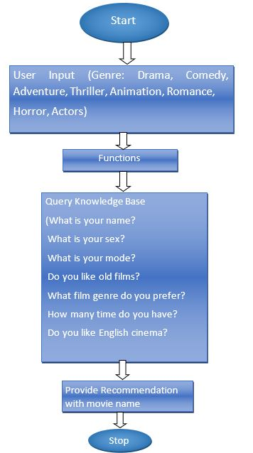
Flow-chart
16/6/23

Slide 9
Result(Output)
“
The output of the Movie Recommendation expert system is a personalized movie recommendation based on the user's preferences. The system presents the user with a movie title, along with additional information such as the year of release, genre, duration, production details, special features, and the main character.
Example output: "You should watch this movie: 'Inception' (2010). It is a thriller movie with a duration of 148 minutes. Directed by Christopher Nolan, it features mind-bending concepts and stunning visual effects."
The system continues to provide recommendations until the user is satisfied or decides to exit the system.
In conclusion, the Movie Recommendation expert system implemented in Prolog aims to assist users in finding movies that align with their preferences and current mood. By gathering user input and matching it with a movie database, the system generates personalized recommendations that enhance the movie selection process.
”
16/6/23

Slide 10
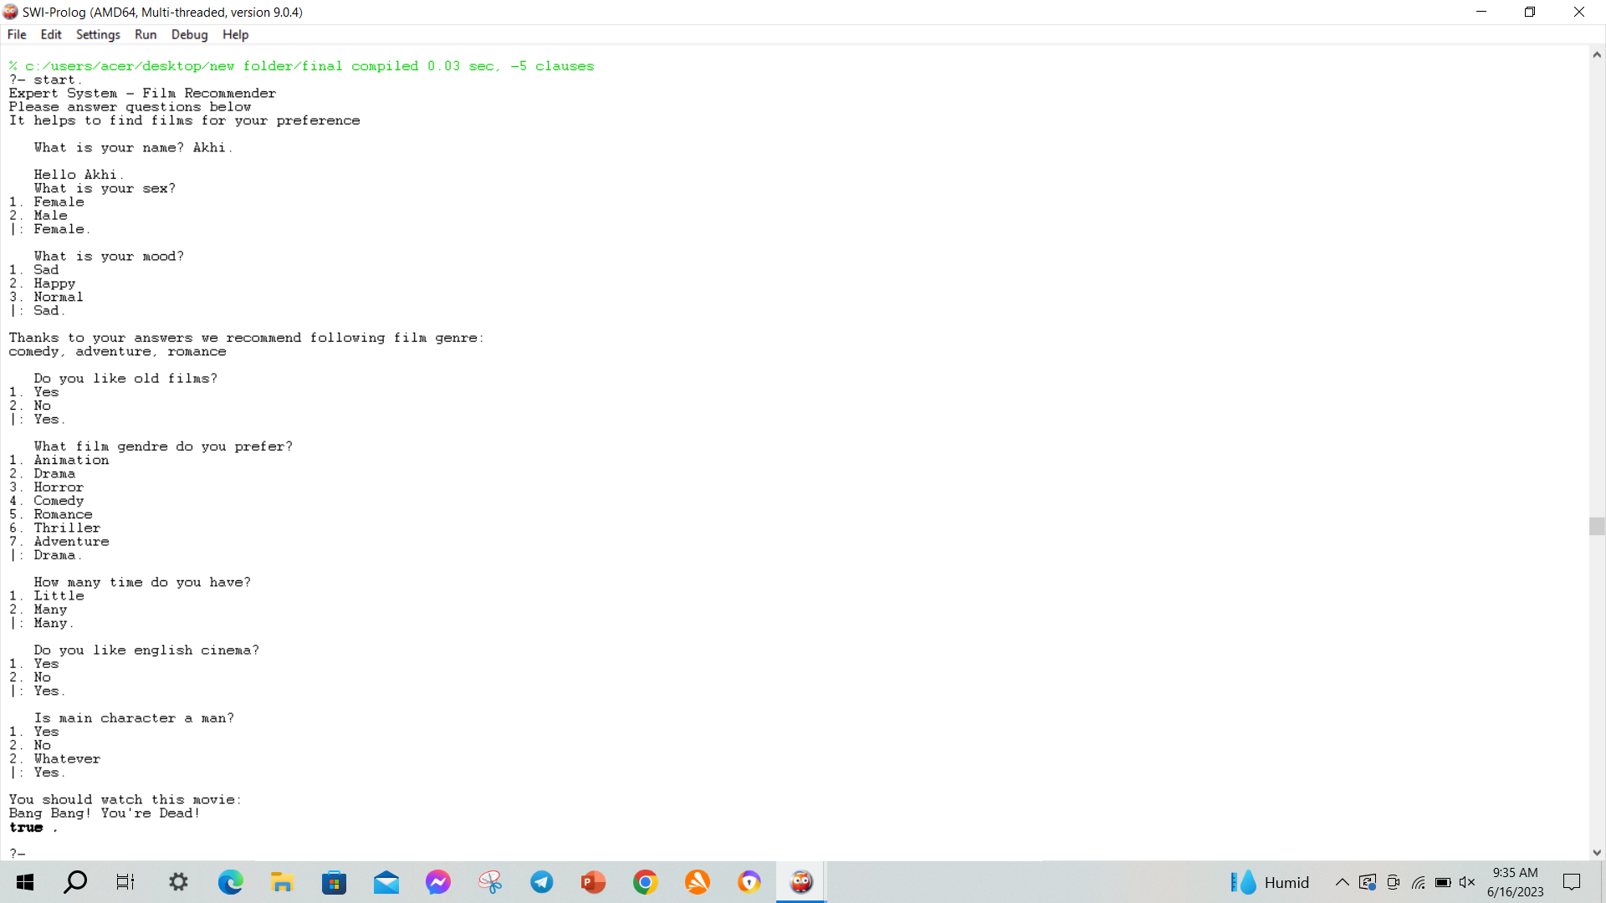
16/6/23

Slide 11
Future Scope
User Feedback and Rating System: Implementing a feedback and rating system would enable users to provide feedback on recommended movies. This feedback can be used to improve the recommendation algorithm and refine the system's suggestions based on user preferences.
Social Media Integration: Integrating the system with social media platforms would enable users to share their movie recommendations with friends, see what movies their friends have watched, and discover new movies based on their social network's recommendations.
User Profiles and Preferences: Creating user profiles to store individual preferences, watch history, and ratings would enable the system to provide more personalized and tailored recommendations over time.
10

Slide 12
Thank you

